Slide 1

Navigating the Low-Carbon Transition: The Role of Decarbonisation Assessment Tools in the Mining Industry
GENG5512
Researcher: Nicholas Butterly
Supervisor: Assoc. Prof. Cosimo Faiello
21714914
07/10/21

Slide 2

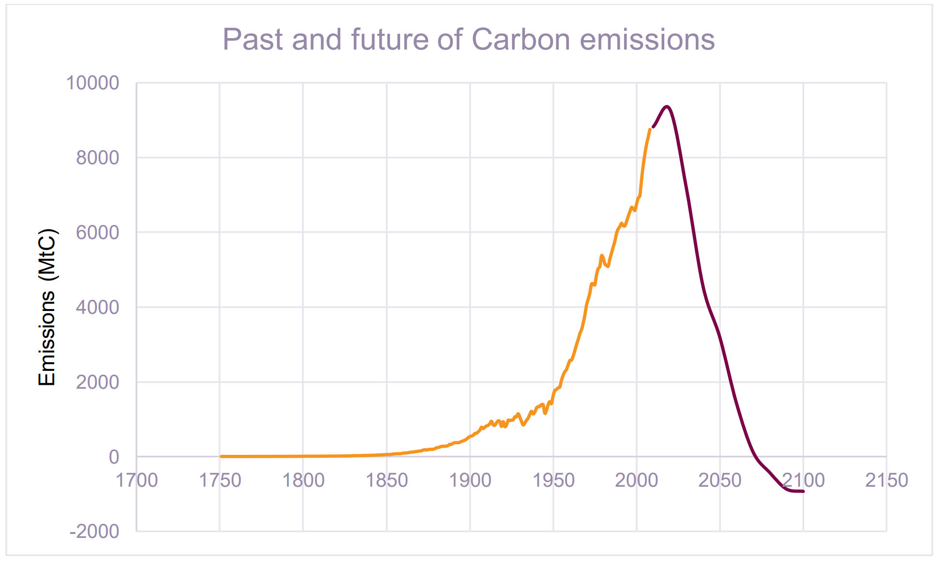
Background
Challenge
ASX100 companies NZE targets:
42% have NZE targets, but…
Only 16% provided emissions reductions plans
Need for new tools to help decarbonisation projects
Developing decarbonisation tools for PM’s & companies

Slide 3

Problem Statement & Research Questions
What is the potential role of sector-based ‘decarbonisation assessment tools’ in helping companies navigate the impending low-carbon energy transition?
Q1: To what extent might the current decarbonisation performance of the Client be quantified using the ACTMM decarbonisation assessment tool?
Q2:
To what extent might the NZE Roadmap Project improve or alter the Client's decarbonisation score?

Slide 4



Approach
P1: Creation of Assessment Tool
ACT Initiative Generic Methodology
P2: Data Collection
Public disclosures
P3: Data Analysis
Q1: Assess a mining company
Interview(s)
Excel Calculation Tool
Q2: Assess a decarbonisation project
Sustainability Reports
Financial Results
Annual Reports
Media Releases

Slide 5
P1
Creation of Assessment Tool (ACTMM)

Slide 6
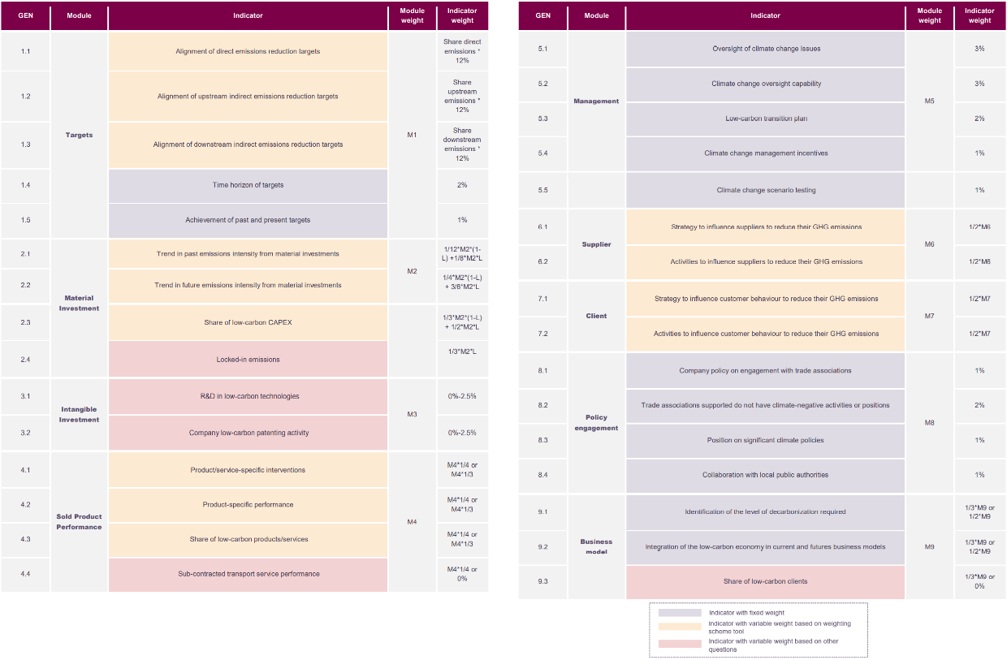
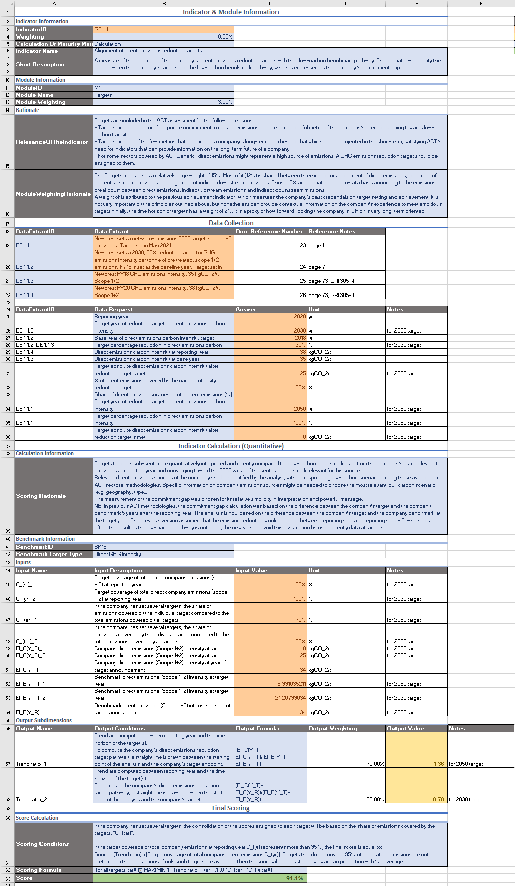
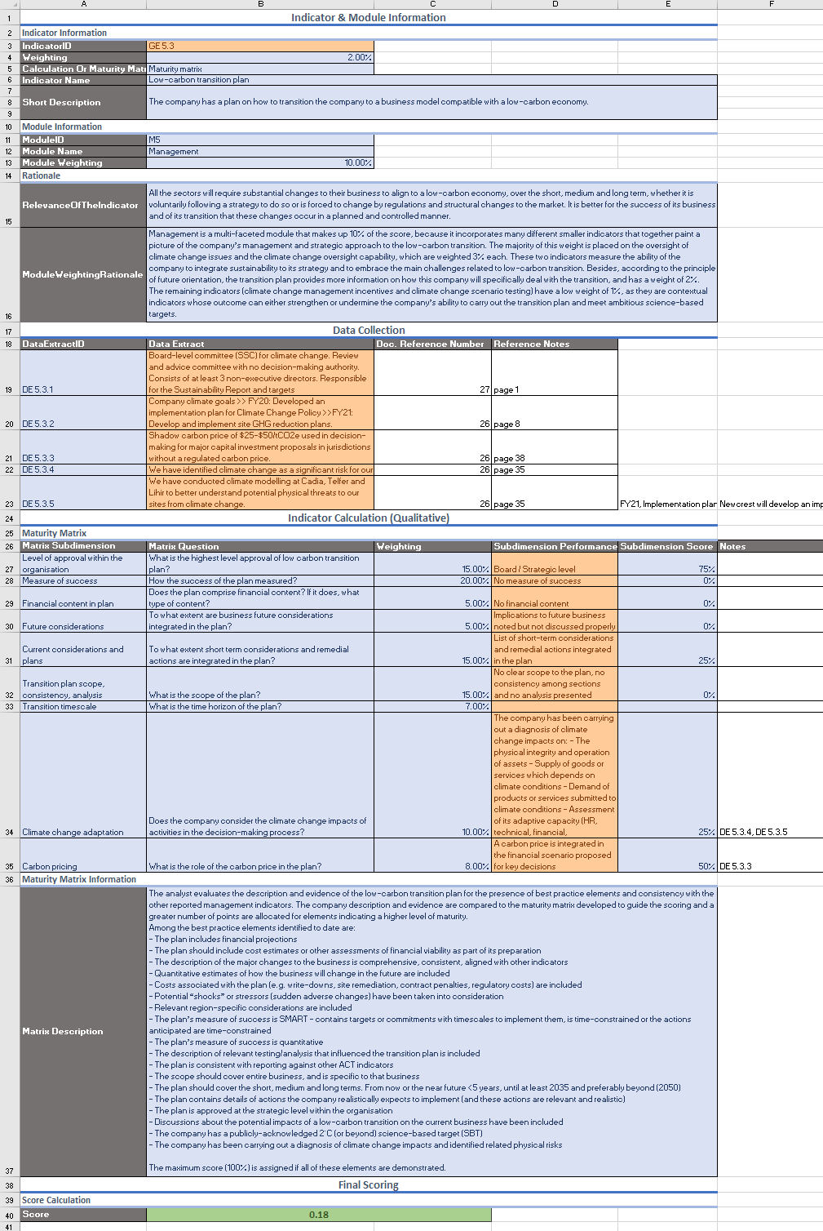

ACT Generic Methodology
Q1, Q2 Excel Calculation Tools

Slide 7
P2
Data Collection

Slide 8
Interview Questions from ACTMM
Maturity Matrix Subdimensions | Interview Questions
Level of approval within the organisation | What is the highest-level approval of low carbon transition plan?
Measure of success | How the success of the plan measured?
Financial content in plan | Does the plan comprise financial content? If it does, what type of content?
Future considerations | To what extent are business future considerations integrated in the plan?
Current considerations and plans | To what extent short term considerations and remedial actions are integrated in the plan?
Transition plan scope, consistency, analysis | What is the scope of the plan?
Transition timescale | What is the time horizon of the plan?
Climate change adaptation | Does the company consider the climate change impacts of activities in the decision-making process?
Carbon pricing | What is the role of the carbon price in the plan?

Slide 9
P3: Q1
Data Analysis
To what extent might the current decarbonisation performance of the Client be quantified using the ACTMM decarbonisation assessment tool?

Slide 11
“30% reduction in GHG emissions intensity per tonne of ore treated by 2030” – Sustainability Report, 2019
“…goal of net zero carbon emissions by 2050” – Market Release, May 2021

Slide 12
Commonwealth Government target:
28% emissions reduction, 2005-2030
-1.305% p.a.
-4.9 kgCO2e/t
+2.6 kgCO2e/t
WA Government target:
Net-zero emissions 2050

Slide 13
SBTi ACA:
IPCC 1.5°C, SR15 Scenario
-4.2% p.a. GHG emissions reduction
-12.8 kgCO2e/t
-9.5 kgCO2e/t

Slide 14
$$2030 Commitment Gap Score=\frac{Company^{′}s target reduction}{Benchmark reduction}=\frac{−9.5 kgCO_{2}/tonne}{−12.8 kgCO_{2}/tonne}×100\%=74.3\%$$
$$2030 Commitment Gap Score=\frac{Company^{′}s target reduction}{Benchmark reduction}=\frac{−9.8 kgCO_{2}/tonne}{−12.8 kgCO_{2}/tonne}×100\%=74.3\%$$
$$2050 Commitment Gap Score=\frac{Company^{′}s target reduction}{Benchmark reduction}=\frac{−25.0 kgCO_{2}/tonne}{− 34 kgCO_{2}/tonne}×100\%=136.0\%⇒100\%$$
$$Final Company Score=0.7×74.3\%+0.3×100\%=92.3\%$$

Slide 15
P3: Q2
Data Analysis
To what extent might the NZE Roadmap Project improve or alter the Client's decarbonisation score?

Slide 16
Subdimension | Basic 0% | Standard 25% | Advanced 50% | NextPractice 75% | LowCarbonAligned 100% | Weighting
Level of approval within the organisation | Not known | Operational level (CSR level) | Upper management level | Board / Strategic level | Matches highest level of responsibility as previously reported | 15%
Measure of success | No measure of success | Measure of success is mainly qualitative | SMART KPI: specific, measurable, acceptable, realistic, time bound. | Measure of success is SMART. Measure of success contains both qualitative and quantitative targets. | Measure of success is quantitative | 20%
Financial content in plan | No financial content | Financial projections, cost estimates or other estimates of financial viability are described but not quantified | Financial projections, cost estimates or other estimates of financial viability are laid out OR short-term actions to start implementing plan are quantified in more detail | Quantitative estimations of how the business will change in the future are included Costs associated with the plan (e.g., write-downs, site remediation, contract penalties, regulatory costs) are included | Description of the major changes to the business is comprehensive, consistent, aligned with other indicators | 5%
Future considerations | Implications to future business noted but not discussed properly | Contains actions the company expects to implement to make the transition a reality without any details | Contains discussion certain current company elements that need to be changed to make the transition a reality | Contains discussion of the potential portfolio of a future, low carbon ready company | Contains one or more elaborate outlines of how the far-future company could look like in terms of physical assets and business model | 5%
Current considerations and plans | Short-term considerations and remedial actions can be discussed but are not integrated in the plan | List of short-term considerations and remedial actions integrated in the plan | Contains discussion of the potential impacts of a low-carbon transition on the current business Relevant region-specific considerations are included | Contains details of actions the company realistically expects to implement (and these actions are relevant and realistic) | Consideration of potential short-term “shocks” or stressors (sudden adverse changes) has been made | 15%

Slide 17
Subdimension | Basic-0% | Standard-25% | Advanced-50% | NextPractice-75% | LowCarbonAligned-100% | Weighting
Transition plan scope, consistency, analysis | No clear scope to the plan, no consistency among sections and no analysis presented | The scope covers the entire business | Plan is consistent with reporting against other ACT indicators Contains a description of relevant testing/analysis | - | Transition covers entire business and is specific to it, with proper scoping, consistency and proper analysis | 15%
Transition timescale | Covers only short-term (< 3 years) | Covers only medium term (< 5 years) | Should cover the short, medium and long term. From now or near future | Covers the short, medium and long term. From now until at least 20 years | Covers the short, medium and long term. From now and beyond (2050) | 7%
Climate change adaptation | The company does not consider climate issues related to its activities and remains passive in the face of climate risks | The company has been carrying out a diagnosis of climate change impacts on: - The physical integrity and operation of assets - Supply of goods or services which depends on climate conditions - Demand of products or services submitted to climate conditions - Assessment of its adaptive capacity (HR, technical, financial, organizational) | The company has been carrying out a diagnosis of climate change impacts and identified related physical risks. It has set up indicators for decision making and impact thresholds | The company has been carrying out a diagnosis of climate change impacts and identified related physical risks. It has set up indicators for decision making and impact thresholds. It has planned actions to reduce its physical risk, taking also into account other environmental issues (impact on climate change mitigation, biodiversity, health and pollution It has defined updating knowledge and learning processes | The company conducts a routine strategy, from diagnosis to action and assessment, including updating knowledge and learning processes. It checks that the adaptation actions do not harm, or even have a positive impact on climate change mitigation, biodiversity, health and pollution. | 10%
Carbon pricing | No carbon price is considered | A carbon price has been considered to elaborate the plan but is not actually considered for the decisions | A carbon price is integrated in the financial scenario proposed for key decisions | The carbon price is integrated in financial scenario proposed regarding all strategic decisions | The carbon price value is aligned with a low carbon scenario used in the methodology and is integrated in financial scenario proposed regarding all strategic decisions | 8%

Slide 18
Q2: Low-Carbon Transition Plan Score
Maturity Matrix Subdimensions | Weighting | FY20 Score | Preliminary FY21 Score
Level of approval within the organisation | 15% | 0.75 | 0.75
Measure of success | 20% | 0 | 0.75
Financial content in plan | 5% | 0 | 0.75
Future considerations | 5% | 0 | 0.5
Current considerations and plans | 15% | 0 | 0
Transition plan scope, consistency, analysis | 15% | 0 | 1
Transition timescale | 7% | 0 | 0.5
Climate change adaptation | 10% | 0.25 | 0.25
Carbon pricing | 8% | 0.50 | 1
WEIGHTED SCORE |  | 23% | 62%

Slide 19
Q1
Q2
To what extent might the current decarbonisation performance of the Client be quantified using the ACTMM decarbonisation assessment tool?
To what extent might the NZE Roadmap Project improve or alter the Client's decarbonisation score?
GHG Emissions Reduction Target Commitment Score:
92.3%
Low-carbon Transition Plan
Score Improvement:
23%→ 62% +39% ppt. increase

Slide 20
Questions

Slide 21
Agenda
Key Details & Background
Problem statement & research questions
Methodology
Timeline – Weekly Milestones
Current Progress & Upcoming Work
Challenges

Slide 22
Key Details
Purpose
Project: Advisian ‘NZE Roadmap’ Project
Framework: Adapted ACT Generic Methodology
ASX100 companies NZE targets:
42% have NZE targets, but…
Only 16% provided emissions reductions plans
Need for new tools to help decarbonisation projects
Developing decarbonisation tools for PM’s & companies

Slide 23
Problem Statement & Research Questions
What is the potential role of sector-based ‘decarbonisation assessment tools’ in helping companies navigate the impending low-carbon energy transition?
Q1: To what extent might the current decarbonisation performance of the Client be quantified using the ACTMM decarbonisation assessment tool?
Q2:
To what extent might the NZE Roadmap Project improve or alter the Client's decarbonisation score?

Slide 24
Methodology
P1: Creation of Assessment Tool “ACTMM”
Adapting existing framework from ‘Assessing low-Carbon Transition Institute’ (ACTi)
Interviewing ACTi Founder and Lead Developer for feedback
P2: Data Collection
Company public disclosures (Sustainability report, GRI300, etc.)
Interview with Project Manager
P3: Data Analysis
Company & project decarbonisation score using ACTMM tool
P4: Finalisation
Seminar
Final Report

Slide 25
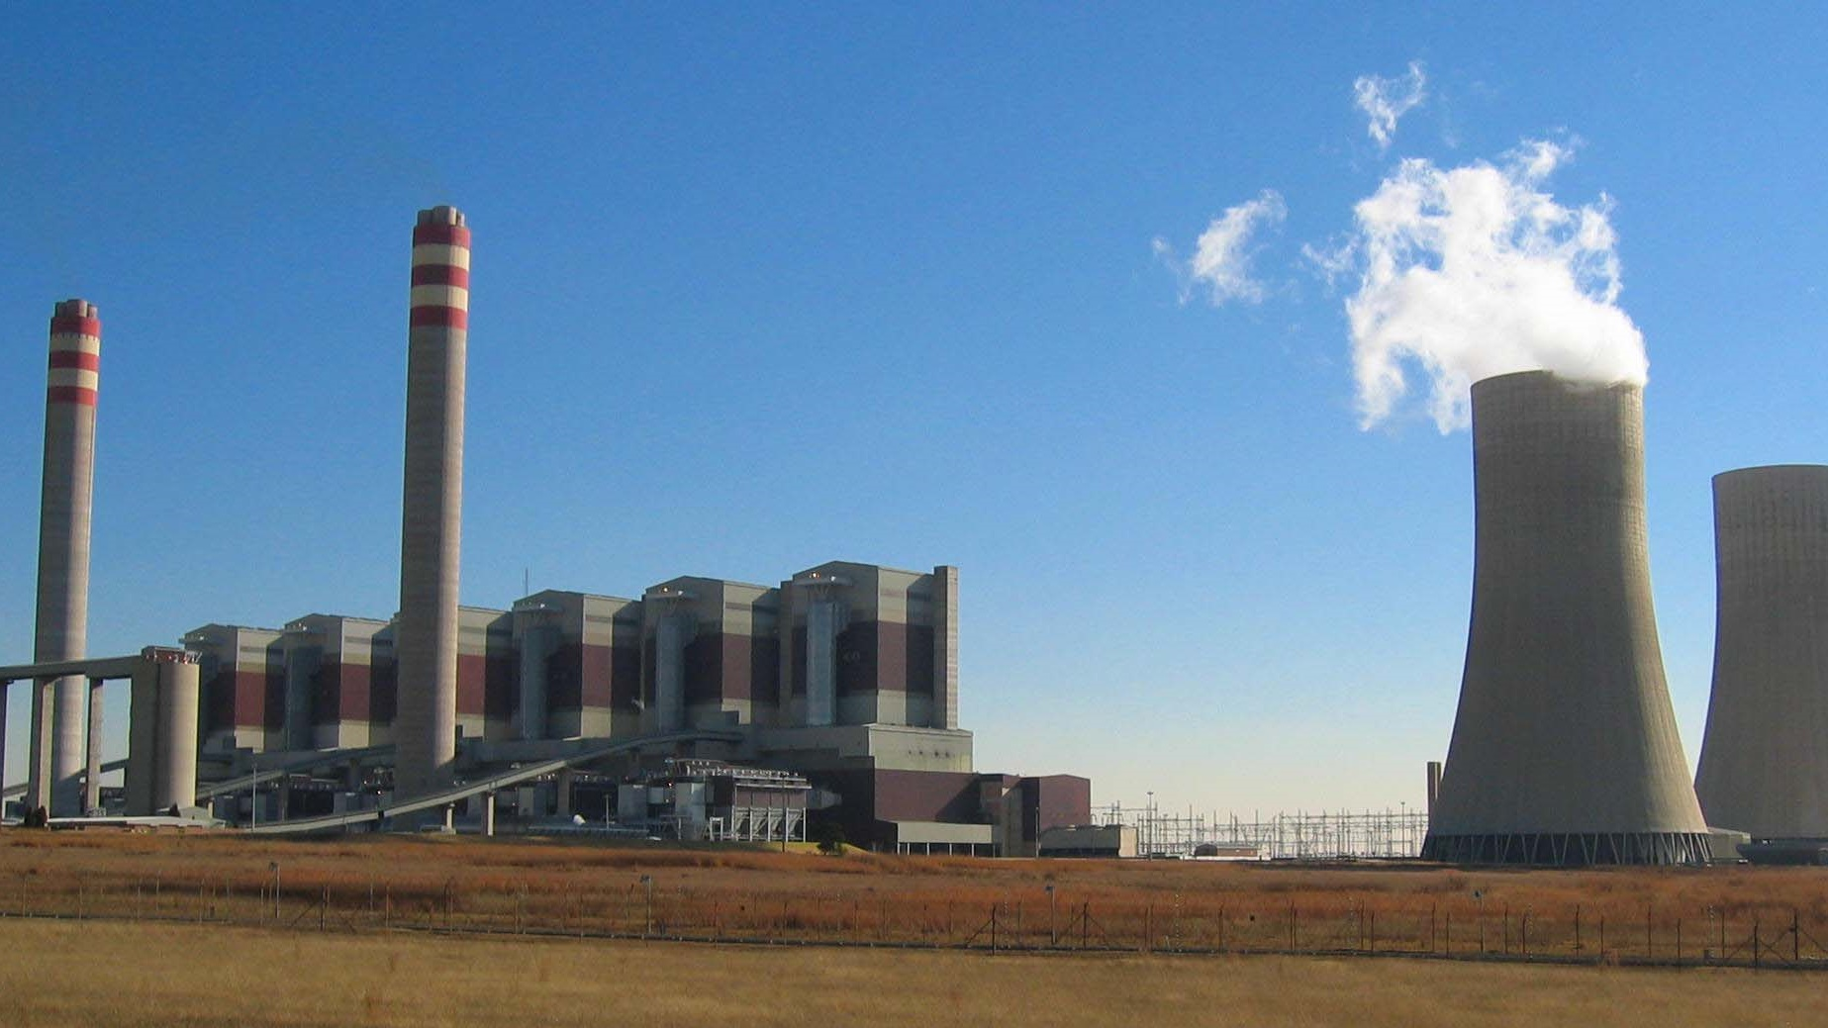
Timeline – Weekly Milestones
Week of 20th Sept
Week of 27th Sept
Week of 4th Oct
Week of 11th Oct
Week of 18th Oct
Collect & process data – Public disclosures
Oral progress report, Ethics application
Begin creating ACTMM
ACTMM prototype
Preliminary results
Ethics approval (Approx. 5th–7th October)
Seminar (Due 8th October)
Interviews ACT, Advisian
Writing final report
Submit final report (Due 25th October)
Final results
ACTMM finalised
Abstract (Due 1st October)

Slide 26
Current Progress
Upcoming Work
Data collection – Public disclosures
Begun adapting ACTGM decarbonisation assessment tool
Advisian & ACTi have agreed to a future interview
Whilst waiting for ethics approval…
Complete ACTMM prototype
Preliminary results using data from public disclosures

Slide 27
Challenges
Ethics approval time uncertainty Response:
Preliminary results using publicly available data
Disclosing Client name Response:
Alternatively, focus on Consultant’s “NZE Roadmap Project” and keep the Client name redacted

